Slide 1
Purpose-Driven Branding

Slide 2
Overview
Brand Purpose and Brand Value
Consumer expectations
Consumer perceptions of purpose-driven branding
Unilever: Purpose-driven leader
Unilever: Counterpoint
Branding for purpose and profit

Slide 3
Brand Purpose and Brand Value
Over a 120-year period, brands with a strong brand purpose grew brand value (i.e., estimated brand equity) at a faster rate:
  Weak brand purpose: 70% growth
  Average brand purpose: 86% growth
  Strong brand purpose: 175% growth
Kantar Media 2021

Slide 4
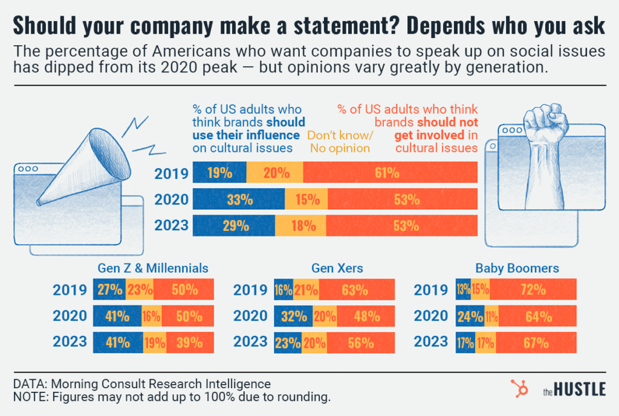
Consumer Expectations

Slide 5
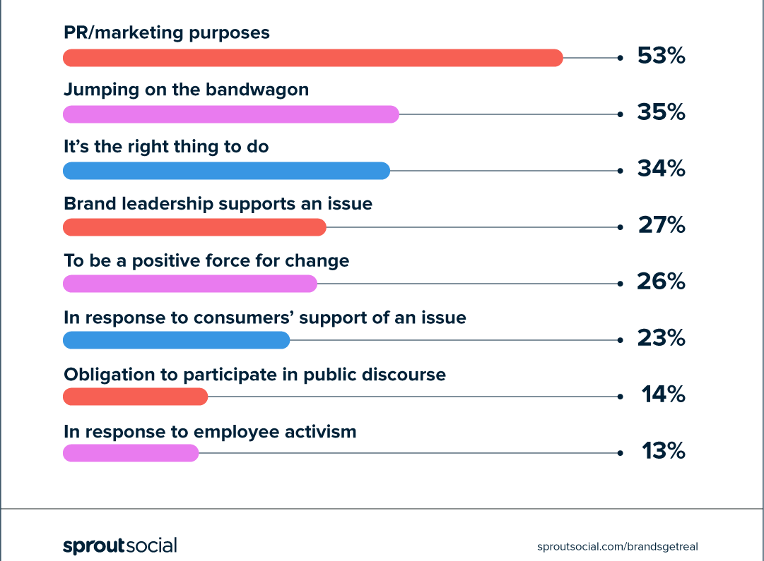
Consumer Perceptions of Why Brands Take a Stand

Slide 6
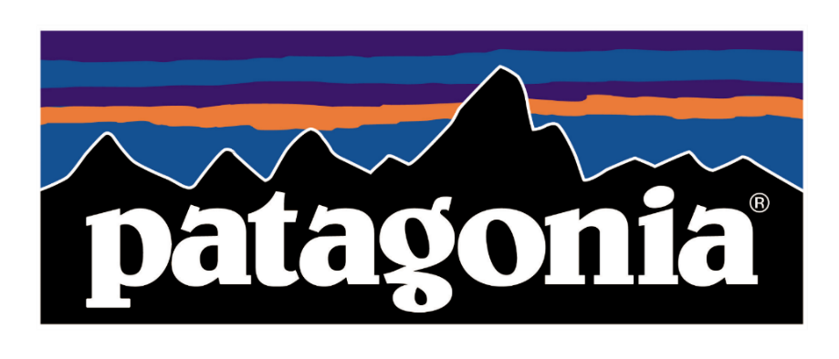

Most Brands Have No Inherent Credibility
Need to avoid perceptions of pandering or hypocrisy
Need to choose an issue with care
Build trust through long-term commitment and resources

Slide 7
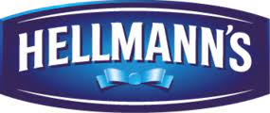

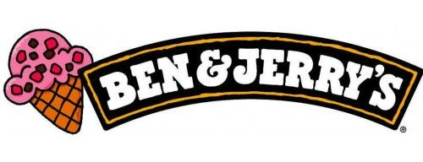

Unilever: Purpose-Driven Superstar
28 “purposeful “ brands
Two-thirds of revenue
75% of sales growth
Goal: every brand has a purpose

Slide 8

Unilever: Counterpoint
Did Unilever “lose the plot”?
  Purpose as an “unwanted distraction”
“Why can’t a brand’s purpose just be a product that works?”
Before worrying about a social purpose, be sure the brand is doing a great job of keeping its basic promise!

Slide 9
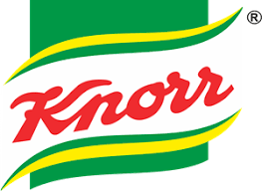

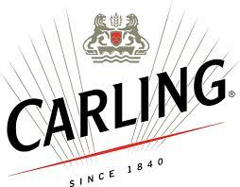
Branding for Purpose and Profit
Inspiring behavioral change—adding greens to stews
Winning internal support—C-suite commitment is key
Measuring performance—handwashing metrics
Securing partnerships—governments and NGOs
Driving systemic change—reducing gender violence

Slide 10
Conclusions
Does your firm engage in purpose-driven branding? If so, how effective is it?
Have you altered any of your own purchase behavior due to brand activism?

Slide 11
End of Lecture

